Slide 1
데이터마이닝 프로젝트
2017년 6월 2일
숭실대학교 컴퓨터학부
기계학습 연구실 채병주

Slide 2
“Default of credit card clients” 데이터
LIMIT_BAL: Amount of given credit in NT dollars (includes individual and family/supplementary credit
SEX: Gender (1=male, 2=female)
EDUCATION: (1=graduate school, 2=university, 3=high school, 4=others, 5=unknown, 6=unknown)
MARRIAGE: Marital status (1=married, 2=single, 3=others)
AGE: Age in years
PAY_0: Repayment status in September, 2005 (-1=pay duly, 1=payment delay for one month, 2=payment delay for two months, ... 8=payment delay for eight months, 9=payment delay for nine months and above)
PAY_2: Repayment status in August, 2005 (scale same as above)
PAY_3: Repayment status in July, 2005 (scale same as above)
PAY_4: Repayment status in June, 2005 (scale same as above)
PAY_5: Repayment status in May, 2005 (scale same as above)
PAY_6: Repayment status in April, 2005 (scale same as above)
BILL_AMT1: Amount of bill statement in September, 2005 (NT dollar)
BILL_AMT2: Amount of bill statement in August, 2005 (NT dollar)
BILL_AMT3: Amount of bill statement in July, 2005 (NT dollar)
BILL_AMT4: Amount of bill statement in June, 2005 (NT dollar)
BILL_AMT5: Amount of bill statement in May, 2005 (NT dollar)
BILL_AMT6: Amount of bill statement in April, 2005 (NT dollar)
PAY_AMT1: Amount of previous payment in September, 2005 (NT dollar)
PAY_AMT2: Amount of previous payment in August, 2005 (NT dollar)
PAY_AMT3: Amount of previous payment in July, 2005 (NT dollar)
PAY_AMT4: Amount of previous payment in June, 2005 (NT dollar)
PAY_AMT5: Amount of previous payment in May, 2005 (NT dollar)
PAY_AMT6: Amount of previous payment in April, 2005 (NT dollar)
default.payment.next.month: Default payment (1=yes, 0=no)

Slide 3
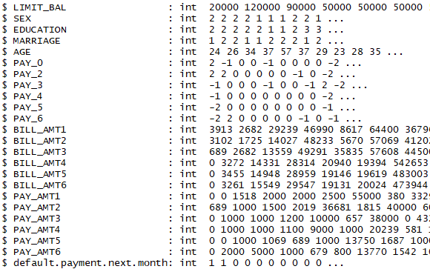
“Default of credit card clients” 데이터 (계속)
str() in R
23 predictors and one response (default.payment,next.month)

Slide 4
프로젝트 개요
데이터 전처리
Predictor 데이터형 변경
SEX, EDUCATION, MARRIAGE: factor
나머지: numeric
Missing value 처리
EDUCATION 및 MARRIAGE
0
PAY_0, 2, 3, 4, 5, 6
0, median, mean
다양한 classification model 성능 비교
Classification에 영향을 주는 predictor 선정

Slide 5
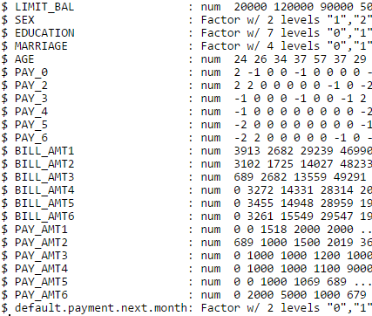
데이터 전처리
SEX, EDUCATION 및 MARRIAGE

Slide 6
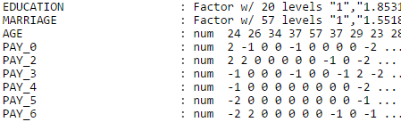


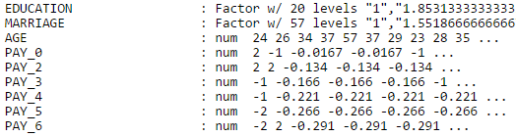
데이터 전처리 (계속)
Missing value (0) 처리
0, median, mean
Missing value ← Mean(data)
Missing value ← Mean(data)

Slide 7
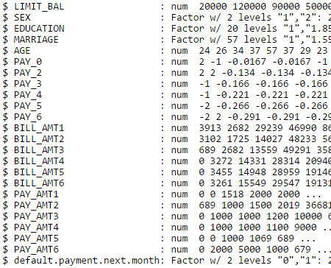
데이터 전처리 (계속)
Missing value 처리 전
Missing value 처리 후

Slide 8
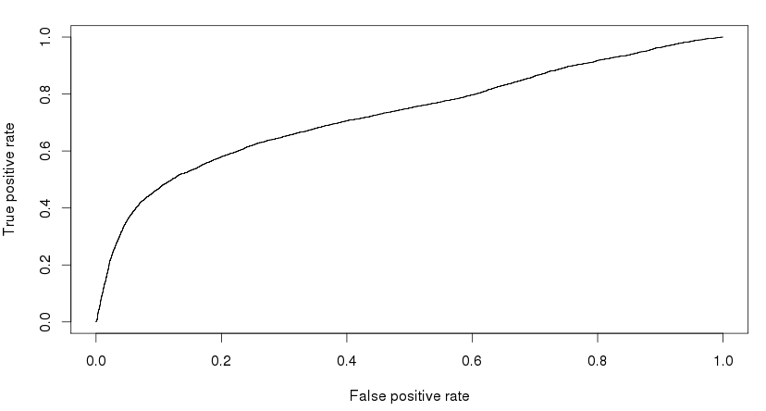
Classification Model 성능 비교
Logistic regression, LDA, QDA, Tree 등
성능 평가 기준
AUC, error rate, sensitivity 등
Logistic regression의 AUC: ~0.73

Slide 9
과제 제출
데이터는 myclass 게시판에서 “default of credit card clients.csv” 다운로드
제출 기한
6월 12일 오후 9시
정보과학관 409호 채병주 조교에게 제출
제출물
보고서 (hardcopy)
문제 및 데이터 설명, 방법 설명, 결과, 결론

